Slide 1
Parameter Estimation and Model Identification for Stationary Models
Introduction and Setting

Slide 2
Parameter Estimation and Model Identification for Stationary Models
Model-free methods
We have studied stationary and non-stationary processes and techniques for their analysis. Some techniques are model-free. That is, we do not need to fit a specific model to the data in order to perform the analysis.
Examples of “model-free” techniques
Windowed spectral estimators
Sample autocorrelations
Filtering procedures

Slide 3
Model-Dependent Techniques
In Units 4,5, and 6 we studied a variety of models.
AR models
Signal-plus-noise models
ARMA models
ARIMA models
Seasonal models
Units 4,5 and 6 were focused on learning the properties of these models.
Unit 7 focused on how to generate forecasts from them.
Key point
The forecasting techniques were based on the assumption that we know the model.

Slide 4
Typical Situation
We are given a realization of time series data for which we may want to forecast future values.
But, we don’t know the model.
Good news
If your data set is a realization from an ARMA, ARIMA, Seasonal, etc. model, good techniques exist for estimating the model.
Bad news
It is highly unlikely that any data set you encounter will actually be a realization from one of these “nice” models.
Good news… remember…
“Essentially all models are wrong but some are useful.” —G. E. P. Box (“father” of modern time series analysis)

Slide 5
Setting
We have a X₁, X₂,… X_{n} realization of time series data.
Goal
Identify an appropriate model
This includes:
Decision about type of model
Does the model need to be stationary or non-stationary?
Is there an underlying signal?
After the type of model is selected, we must estimate the model parameters.

Slide 6
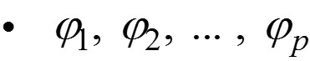
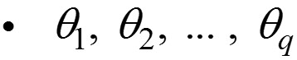
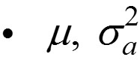
First – We consider stationary models
Suppose that we have decided to fit a stationary ARMA(p,q) model to the data X₁, X₂, … X_{n}.
In this case, we need to estimate:
p and q
—called model identification
called parameter estimation

Slide 7
Strategy
Although identification (ID) of p and q is the first step in the analysis, many model ID techniques involve parameter estimation.
So, we will cover parameter estimation techniques before discussing model ID.
In practice, we use computer packages to perform the calculations.

Slide 9
Estimation Methods for Stationary Models

Slide 10
Note about tswge estimation functions:
est.arma.wge
Maximum likelihood estimation only
est.ar.wge
Maximum likelihood
Yule-Walker
Burg
That is:
For ARMA(p,q) models with q > 0, tswge only produces maximum likelihood estimates
For AR(p) models, tswge provides ML, YW. and Burg estimates

Slide 12
Maximum Likelihood Estimation

Slide 13
Maximum Likelihood (ML) Estimation
Widely used throughout statistical analysis
Involves maximizing the likelihood function L = f(x₁, x₂,…, x_{n}), which is the joint distribution of the time series realization
Iterative, computationally intensive procedure
Involves distributional assumptions about white noise (we will assume normal white noise)
Is applicable to AR(p), MA(q), and ARMA(p,q) models
Will typically use ML estimates for our final models

Slide 15
tswge
Maximum Likelihood Estimation

Slide 16
We will generate realizations from AR and ARMA models, and find ML estimates (assuming we know p and q).
The key function for ML estimation in an ARMA model is est.arma.wge(data,p,q).
Type is ‘mle’
If you know that the model is a AR(p) model, then you can also use est.ar.wge(data,p,q,type).
Type can be ‘mle’ (default), ‘yw’, or ‘burg’

Slide 17
x21=gen.arma.wge(n=100,phi=c(1.6,-.8),theta=.8,vara=5,sn=55)
x21=x21+50 # gen.arma generates data from a zero
# mean model. We use this strategy to generate the
# AR(2) model with mean 50.
est.arma.wge(x21,p=2,q=1)
mean(x21)
Lots of output is generated. Among the output, you will see
$phi
[1] 1.6443723 -0.8146435
$avar
[1] 5.186772
$theta
[1] 0.8699951
> mean(x21)
[1] 49.9592
The final estimated model is

Slide 18
x40=gen.arma.wge(n=100,phi=c(0,-.7,.1,-.72),vara=10,sn=72)
x40=x40+20
est.ar.wge(x40,p=4,type='mle')
# or you could use est.arma.wge(x40,p=4)
mean(x40)
Among the output, you will see
$phi
[1] 0.05656755 -0.68759141 0.11266029 -0.68184277
$avar
[1] 8.776949
> mean(x40)
[1] 19.98281
The final estimated model is:

Slide 20
Yule-Walker Estimation

Slide 21
Alternative Estimators for AR(p) Models
Yule-Walker estimators
Also, recall that for a zero mean process, E[X_{t} X_{t+k}] = E[X_{t-k} X_{t}] = γ_{k}.
Consider the (zero mean) AR(p) model
So, for k > 0, we have
Light board
γ_{k}
So,

Slide 22
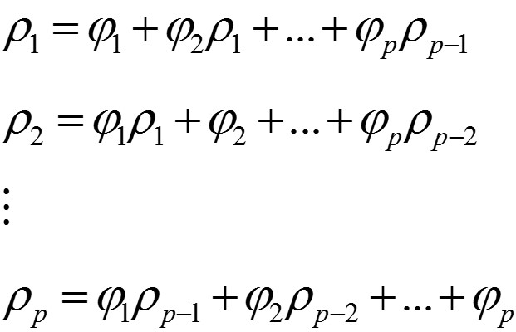
Yule-Walker estimators
Light board
Dividing both sides by γ₀, we get
Letting k = 1, 2,… , p, we get the well-known
Yule-Walker equations

Slide 23
Estimate , where
Solve the resulting equations for and denote these estimates .
Called Yule-walker estimates

Slide 25
Burg Estimation

Slide 26
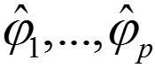
Burg estimates
Light board
•••
Use least squares to find that minimize

Slide 28
Burg Estimation

Slide 29
Burg estimates
Note, we had to begin the equations at X_{p+1} because X₁,…, X_{p} involve values such as X₀, X_{–1}, and so on that are not observed
This is unfortunate because we’re nearly “throwing away” X₁,…, X_{p}
In AR models, there is no preference in time direction (recall ρ_{k} = ρ_{−k})
Process “driving process forward” also drives it backward

Slide 30
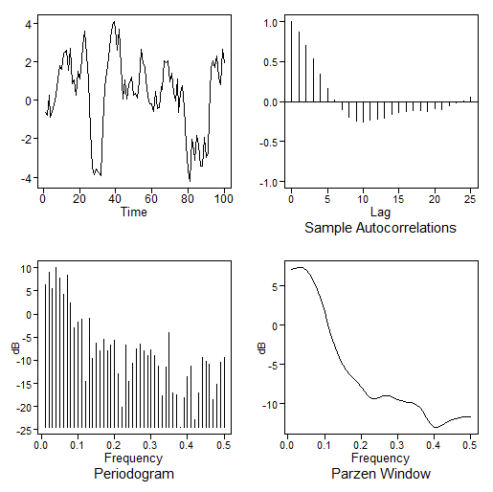
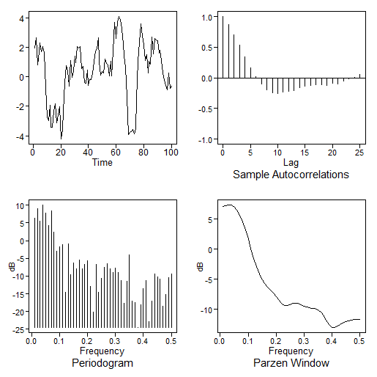
Burg estimates
AR(1) Realization
Realization “reversed” in time
x40
rev(x40)
acf(x40)
acf(rev(x40))
“Flipping the time (horizontal axis) does not change the general appearance or apparent correlation structure of the realization.”

Slide 32
Burg Estimation
The Backward Model

Slide 33
Burg estimates
“Backward” model
Light
board
•••
Forward-backward least squares (FBLS) estimates found by minimizing
FBLS makes better use of all of the data.

Slide 34
Burg estimates
Burg used the Durbin-Levinson algorithm to minimize FBSS under the constraint that the model is stationary.
These estimates are called “Burg” estimates
Burg algorithm given in Woodward et al. (2017)

Slide 36
tswge and Estimation

Slide 37
tswge demo
tswge function est.ar.wge computes the following types of estimates:
yw
burg
mle
est.ar.wge(x, p, factor = TRUE, type )
x=gen.arma.wge(n=200,phi=c(1.6,-.9),vara=2,sn=33)
x.yw=est.ar.wge(x,p=2,type='yw')
x.yw
x.burg=est.ar.wge(x,p=2,type='burg')
x.mle=est.ar.wge(x,p=2,type='mle')
All three estimation types (yw, burg, and mle) gave good estimates of the parameters ϕ₁ = 1.6 and ϕ₂ = −.9.
Note that x.yw, x.burg and x.mle displays details about the respective estimates.
We see that all three methods yield white-noise variance estimates close to 2.12

Slide 39
Comparing Estimates

Slide 40
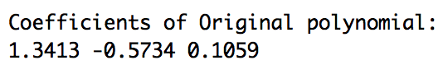
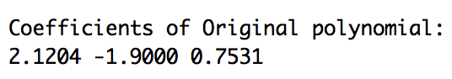
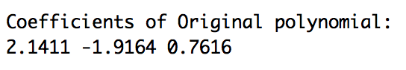
tswge demo
Real root very close to unit circle
Factor Abs recip System freq
1-0.995B 0.9950 0.0
1-1.2B+0.8B² 0.8944 0.133
x=gen.arma.wge(n=100,phi=c(2.195,-1.994,.796), sn=53)
x.yw=est.ar.wge(x,p=3,type='yw’)
x.burg=est.ar.wge(x,p=3,type='burg’)
x.mle=est.ar.wge(x,p=3,type='mle’)

Slide 41
tswge demo
Real root very close to unit circle
Factor Abs recip System freq
1 – 0.995B 0.9950 0.0
1 – 1.2B + 0.8B² 0.8944 0.133
ϕ₁
ϕ₂
ϕ₃
True | 2.195 | –1.994 | .796
YW | 1.34 | –0.57 | .11
Burg | 2.12 | –1.90 | .75
MLE | 2.14 | –1.92 | .76
Roots close to unit circle causes problems with YW!
Recommendation:
Don’t use Yule-Walker estimates.

Slide 43
Estimation Summary

Slide 44
Estimation Summary
The functions est.arma.wge and est.ar.wge are for finding stationary models when you know p and q.
For ARMA models with q > 0, we will always find ML estimates using est.arma.wge.
Maximum likelihood techniques are computationally intensive in the ARMA and AR setting and must be found iteratively
est.arma.wge may sometimes find models with roots inside the unit circle
These models should not be used as final models.

Slide 45
Estimation Summary
For AR models, we have three choices available through est.ar.wge:
ML
Has the best mathematical properties
But it may sometimes find models with roots inside the unit circle
Yule-Walker
A very popular estimation technique
Fast/non-iterative in nature
Will always find a stationary AR model
However, it should not be used due to limitations that will be discussed
Burg
Fast/non-iterative in nature
Will always find a stationary AR model
Is preferable over Yule-Walker

Slide 47
Estimation of White-Noise Variance

Slide 48


Estimating $_{a}^{2}$
Given a model (assuming μ = 0)
and solving for $a_{t}$, we get
Given an estimated model, we can estimate the noise
tswge uses a procedure called backcasting (see Woodward et al. (2017) to find estimates)

Slide 49
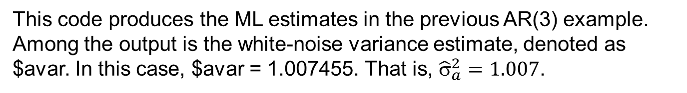
Estimating $_{a}^{2}$
tswge estimates $_{a}^{2}$ using the “backcast” residuals.
tswge example
x=gen.arma.wge(n=100,phi=c(2.195,-1.994,.796), sn=53)
x.mle=est.ar.wge(x,p=3,type='mle')
x.mle
This code produces the ML estimates in the previous AR(3) example. Among the output is the white-noise variance estimate, denoted as $avar. In this case, $avar = 1.007455. That is, ${\hat{σ}}_{a}^{2}=1.007$.
Note: By default, $_{a}^{2}$ = 1 in gen.arma.wge.

Slide 50
Summary
In this course, we will estimate μ by $\overline{X}$ and $_{a}^{2}$ by
And will use these estimates in our final models
Important notes:
We have obtained the parameter for stationary ARMA models assuming we know p and q
When analyzing an actual data set, we will not know p and q
We address the identification of p and q for stationary ARMA models next

Slide 52
Model Identification | Introduction

Slide 53
ARMA Model Identification
Given X₁,..., X_{n}—a realization from an ARMA (p,q) model—we want to estimate p and q.
“Estimating” p and q is called model identification. A number of techniques are available. Among these, the two most popular are:
AIC-type model identification
Box-Jenkins model identification
A classical approach that is still used by some time series analysts
We recommend the AIC-type model identification, although we will address both for completeness.

Slide 55
First Step
Check for White Noise!

Slide 56
First step: Test for white noise.
A common (and embarrassing/costly) mistake is to spend time and resources fitting an ARMA(p,q) model to a set of data when actually the data are white noise—and do not require modeling.
Before modeling further, check for white noise.

Slide 57
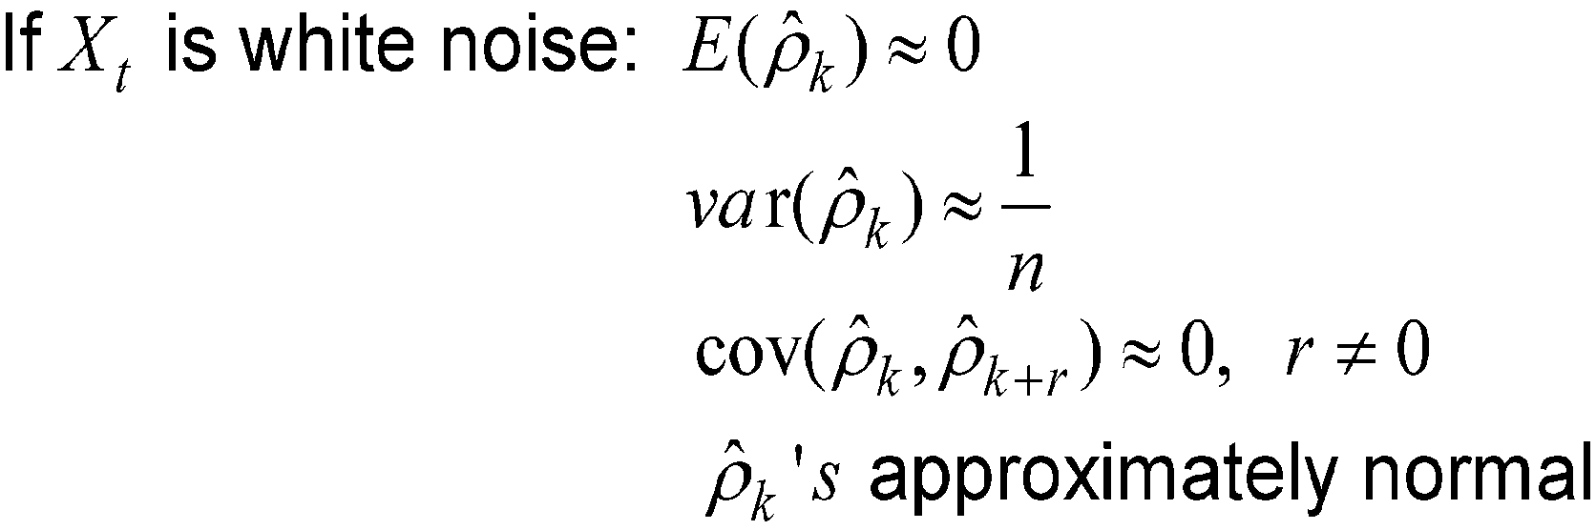
Tests for white noise:
k > 0

Slide 58
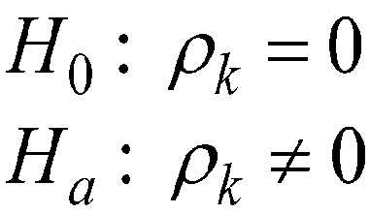
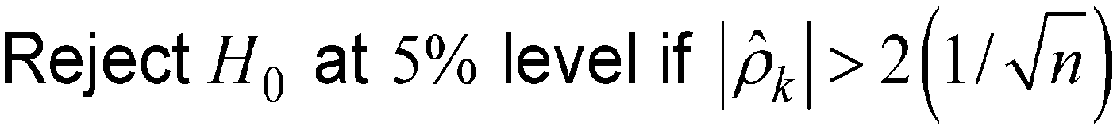
Test the hypotheses:
Notes:
5% applies separately for each k and so approximately 5% of the sample autocorrelations may be outside the limits when data are white noise.
If these occurrences are for small lags, continue modeling.

Slide 59
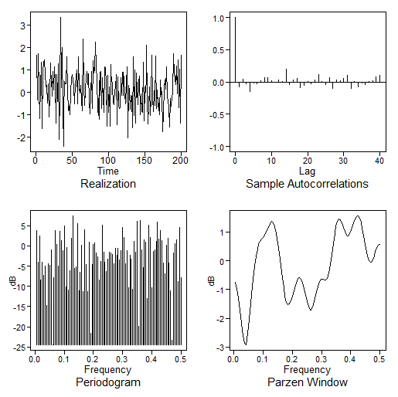
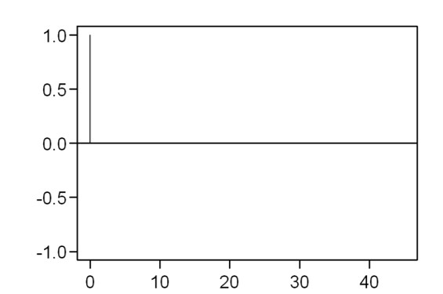

White Noise
Realization
True autocorrelations
Lag
Sample autocorrelations
Sample autocorrelations
95% limit lines

Slide 60
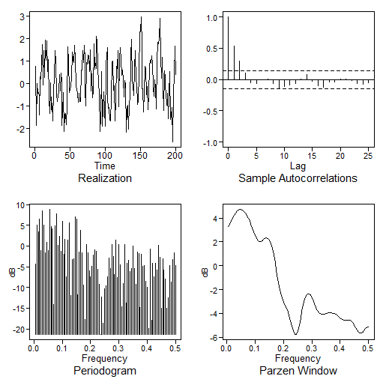
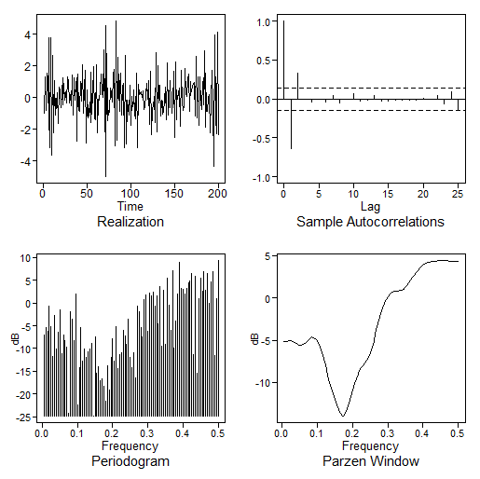
Observations
Sample autocorrelations
Only 2 out of 25 sample autocorrelations lie outside limit lines
Sample autocorrelations look correlated
Damped exponential pattern at early lags
Not white noise
What model?
Realization
Sample autocorrelations
Observations
Realization
Only 2 out of 25 sample autocorrelations lie outside limit lines
There is a distinct drop in magnitude of sample autocorrelations after lag 2
Not white noise
What model?

Slide 61
Other tests for white noise
Portmanteau tests (discussed in Chapter 9, Woodward et al. (2017) and in a Unit to come.)
Cumulative spectrum
Tests for randomness

Slide 62
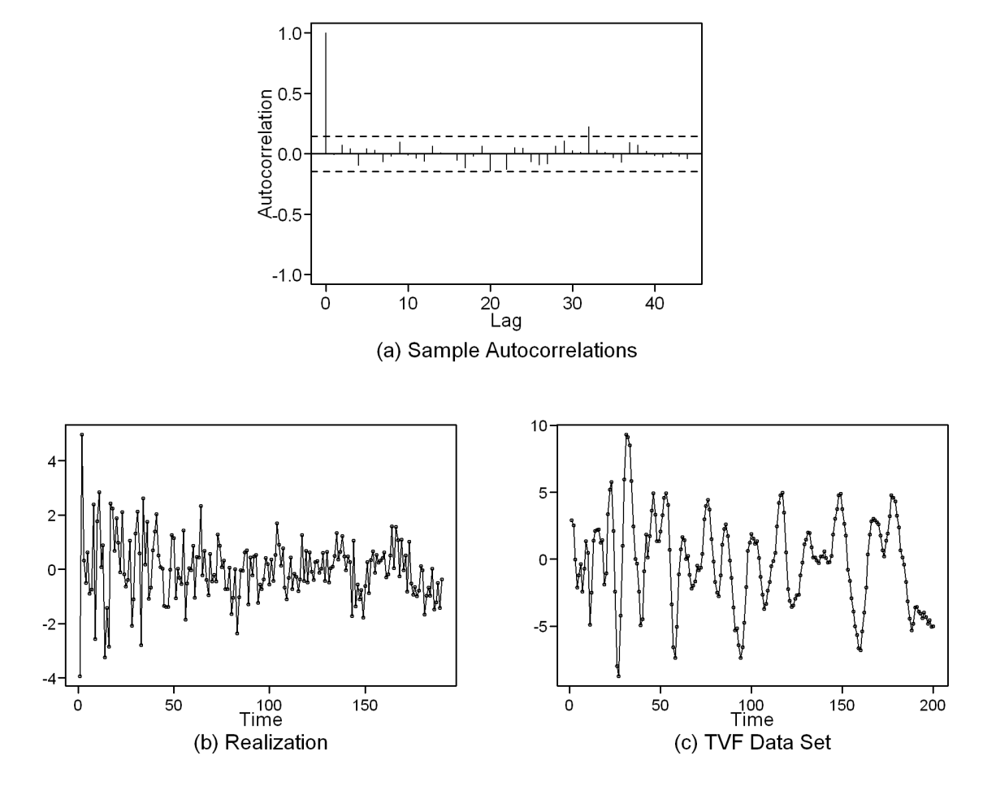
Another Example
Sample Autocorrelations
Observations
Only 1 of 40 sample autocorrelations lie outside limit lines
Sample autocorrelations look uncorrelated
Sample autocorrelations indicate white noise
Realization
Observations
Higher variability early in realization
Definitely not simply random noise
Realization indicates data are NOT white noise
Even though sample autocorrelations suggested white noise

Slide 63
Lesson
Always plot the data!

Slide 65
Model Identification | AIC-Type
Introduction

Slide 66
Suppose that we have decided that the data are not white noise, and we wish to fit an appropriate AR/ARMA model to the data.
First step: Check for White Noise
Second step: Identify/estimate p and q.
Method 1: AIC
Method 2: Box-Jenkins

Slide 67
Suppose that we have decided that the data are not white noise, and we wish to fit an appropriate AR/ARMA model to the data.
Second step: Identify/estimate p and q.
Method 1: AIC
Method 2: Box-Jenkins

Slide 68
AIC
Akaike’s Information Criterion
A general criterion for statistical model identification that you have seen before in other settings
Is applicable to the problem of identifying p and q in an ARMA model
AIC is actually one of a number of information-based criteria for model selection; others include:
AICC
BIC
Others
The technique we recommend
Here, the term AIC is used generically to represent the information-based techniques

Slide 70
AIC in General

Slide 71
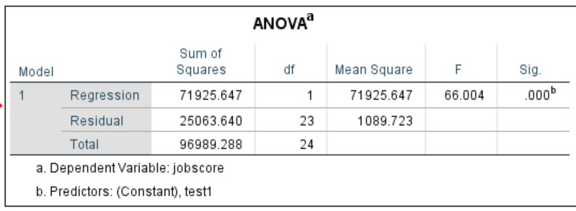
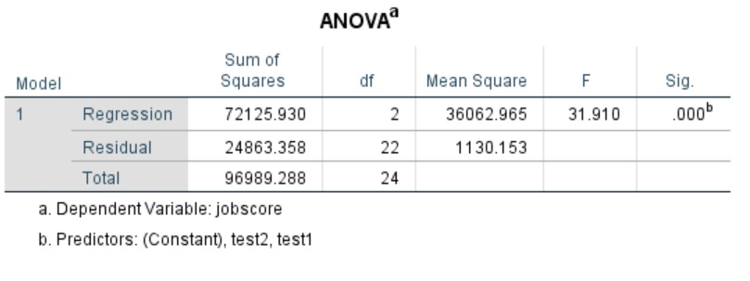
Multiple Regression Example
Job Score: measure of job performance Test1 and Test2: skills tests
Question: Can skills tests predict job performance, and which tests are needed?
Prediction just using Test1
“Unexplained sum-of-squares”
Job Score= -87.136+2.575*Test1
Will using Test1 and Test2 help explain more?
“Unexplained sum-of-squares” is smaller ⇒ use Test2?
Job Score= -93.71+2.534*Test1+.106*Test2

Slide 72
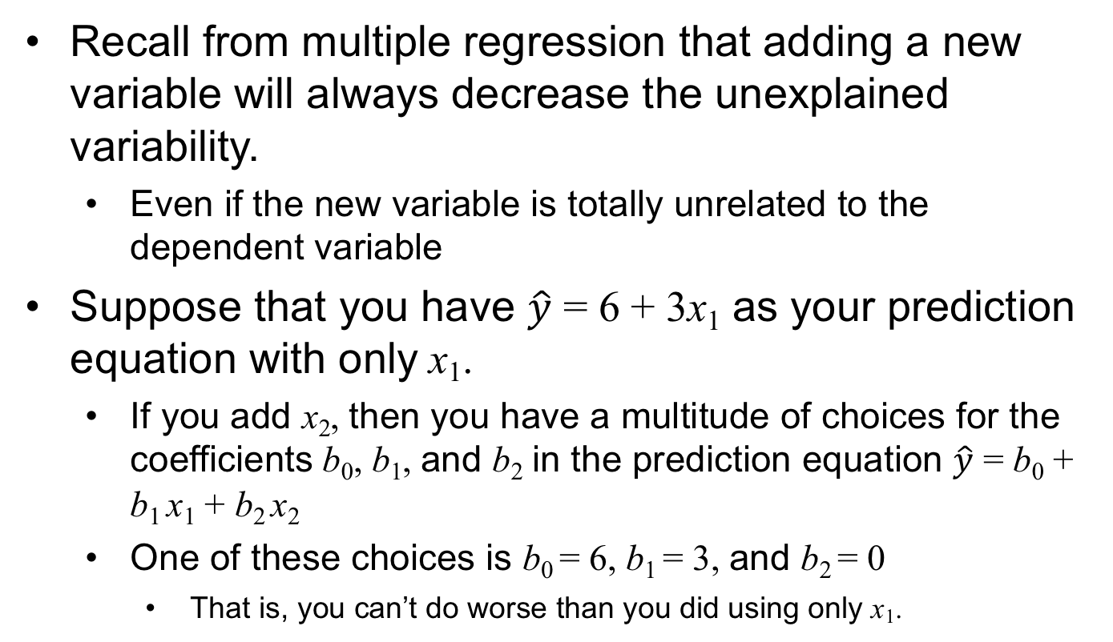
Comments
Recall from multiple regression that adding a new variable will always decrease the unexplained variability.
Even if the new variable is totally unrelated to the dependent variable
Suppose that you have $\hat{y}$ = 6 + 3x₁ as your prediction equation with only x₁.
If you add x₂, then you have a multitude of choices for the coefficients b₀, b₁, and b₂ in the prediction equation $\hat{y}$ = b₀ + b₁ x₁ + b₂ x₂
One of these choices is b₀ = 6, b₁ = 3, and b₂ = 0
That is, you can’t do worse than you did using only x₁.
NOTE: The multiple regression example is from Elliott and Woodward (2016), and the computer output is from IBM SPSS.

Slide 73
Recall: in multiple regression
Adding variables to an existing equation will always reduce the residual/unexplained variability
So, the fact that the residual/unexplained variability is reduced by adding a new variable is not sufficient evidence to conclude that the new variable is important to the prediction
Our goal is to reduce the residual/unexplained variability—to a point
If the goal were to reduce residual/unexplained variability as much as possible, we would always use all the available independent variables.

Slide 74
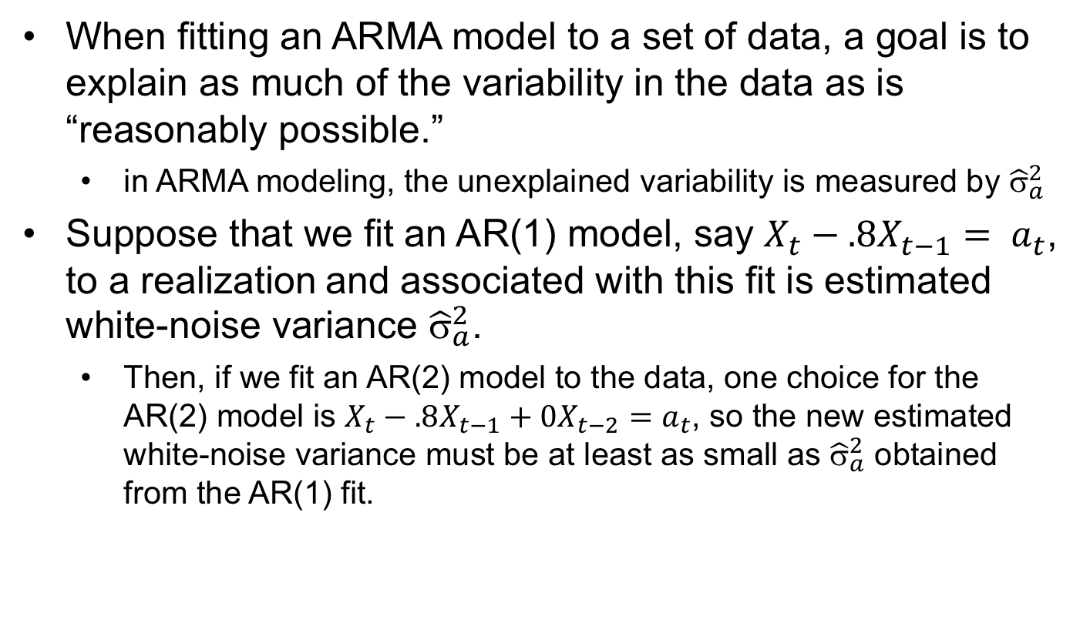
Key point: ARMA modeling is similar
When fitting an ARMA model to a set of data, a goal is to explain as much of the variability in the data as is “reasonably possible.”
in ARMA modeling, the unexplained variability is measured by ${\hat{σ}}_{a}^{2}$
Suppose that we fit an AR(1) model, say $X_{t}−.8X_{t−1}= a_{t}$, to a realization and associated with this fit is estimated white-noise variance ${\hat{σ}}_{a}^{2}$.
Then, if we fit an AR(2) model to the data, one choice for the AR(2) model is $X_{t}−.8X_{t−1}+0X_{t−2}=a_{t}$, so the new estimated white-noise variance must be at least as small as ${\hat{σ}}_{a}^{2}$ obtained from the AR(1) fit.

Slide 76
AIC in ARMA Modeling

Slide 77
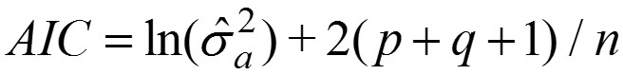
In ARMA modeling, we need a strategy for increasing the order of our model only if the increase in order is sufficiently helpful.
AIC: imposes a penalty for adding terms
Theoretically involves maximized likelihood considerations
We will use the following approximate AIC that is easy to interpret and implement:
Select the ARMA(p,q) model for which
is minimized.

Slide 78
AIC Criterion
Select the ARMA(p,q) model for which
is minimized.
Comments:
The AIC decision rule is to choose the orders p and q that reduce the (ln) white-noise variance subject to a penalty for increasing the number of parameters.
A variety of other penalty functions have been proposed. Two that are discussed in Woodward et al. (2017) and included as options in tswge are:
AICC
BIC

Slide 79
AIC Comments
AIC has a tendency to select a higher-order model as the realization length increases.
BIC imposes a stronger penalty for increasing p and q .
It tends to pick models with fewer parameters.
It avoids the problem of “over-modeling” large data sets.
AICC has a penalty between that for AIC and BIC.
AIC and its variations are for selecting a stationary ARMA model.

Slide 81
AIC in tswge

Slide 82
AIC in tswge
AIC is implemented by specifying a range of values for p and q that will be considered as possible model orders.
Given a p,q pair in the specified range, an ARMA(p,q) model is fit to the data and AIC is calculated.
This procedure is repeated for each p,q pair in the range.
Example: p=0:2, q=0:1 means that the following ARMA(p,q) models will be fit to the data
ARMA(0,0) ARMA(0,1)
ARMA(1,0) ARMA(1,1)
ARMA(2,0) ARMA(2,1)
If the ARMA(p₁,q₁) model has the smallest AIC value, then p₁ and q₁ are selected as the model orders.

Slide 83
AIC in tswge
tswge has two functions that use AIC (and its variations) for model identification:
aic.wge
aic5.wge
aic.wge: Call statement:
aic.wge (x,p=0:5,q=0:2,type="aic")
Input:
x is the data set p=p1:p2, q=q1:q2 (default: p=0:5 and q=0:2) type: aic (default), bic, or aicc.
Output:
value: smallest value of selected type (aic, bic ,or aicc) p and q selected phi and theta estimates (MLE) vara: white-noise variance estimate for “best” model

Slide 85
tswge
AIC Demo

Slide 86
tswge AIC demo
# fig3.16a is a realization from the AR(3) model
data(fig3.16a)
# plotts.sample.wge provides a “look” at the # data (which we recommend you always do)
plotts.sample.wge(fig3.16a)
aic.wge(fig3.16a,p=0:5,q=0:2, type='aic')
Notes:
Selects AR(3)
phi estimates: [1] 2.5245680 -2.3447622 0.8104239
vara=[1] 1.030867
Final model:
(mean(fig3.16a)=1.57)

Slide 87
tswge AIC demo
x=gen.arma.wge(n=100,phi=c(1.6,-.9),theta=.8,sn=67)
x=x+10
plotts.sample.wge(x)
# no type listed below so it will use aic
aic.wge(x,p=0:8,q=0:4)
# picks ARMA(2,1)
est.arma.wge(x,p=2,q=1)
$phi [1] 1.6194830 -0.9131788
$theta [1] 0.868127
$vara [1] 1.076196
Final model:
(mean(x)=10.08)

Slide 89
A Comment about Model ID in Practice

Slide 90
A Comment about Model Identification
The previous two examples may have left the impression that, given data from an ARMA(p,q) model, AIC will correctly identify the model orders.
In Practice
AIC or other criteria will not always identify the order (even when data are from an ARMA model).
As mentioned before, real data will not be ARMA to start with.
The goal is to find the “best” model in some sense.
AIC, BIC, and AICC try to explain as much of the variability as possible.
They attempt to minimize the white-noise variance
With a constraint on too many parameters

Slide 91
Comments
Sometimes AIC (or BIC, AICC) will select a model that “you don’t like.”
It has more parameters than needed.
Some AR and MA factors nearly cancel.
Certain factors of the model seem so weak (roots far away from the unit circle) that they seem pointless.
The model is not stationary (or not invertible).
In this case, it would be helpful to view not just the model with the smallest AIC, but maybe the smallest five: aic5.wge().
Or, you may want to try another information criterion.
BIC might be an option if the model seems to have too many parameters.

Slide 93
tswge and AIC5/Top 5 Models

Slide 94
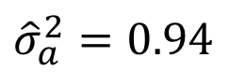
tswge AIC demo
x31=gen.arma.wge(n=75,phi=c(2.3,-1.92,+.56),theta=-.8,sn=61)
x31=x31+30
plotts.sample.wge(x31)
aic5.wge(x31,p=0:8,q=0:2)
# picks (6,1) try BIC
aic5.wge(x31,p=0:8,q=0:2,type="bic")
# BIC picks (3,1) – decide to use it
# showing est.arma.wge results for ARMA(3,1)
est.arma.wge(x31,p=3,q=1)
mean(x31)
# mean is 25.74
Final model:
$${\hat{σ}}_{a}^{2}=0.94$$

Slide 95
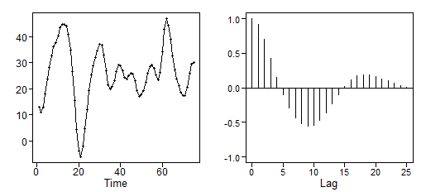
tswge output and discussion
plotts.sample.wge(x31)
Sample autocorrelations look like a damped sinusoid and the data are pseudo-cyclic.
aic5.wge(x31,p=0:8,q=0:2)
AIC picks an ARMA(6,1) with an ARMA(3,1) as a third choice.
ARMA(6,1) and ARMA(7,1) are fairly high-order.
Is there a lower-order model that is reasonable?
Five Smallest Values of aic
p q aic
6 1 0.04601791
7 1 0.05788330
3 1 0.06646122
8 1 0.07820027
4 1 0.08249288

Slide 96
tswge output and discussion
Factor Table for AR(6) Part
The 6th-order model is probably okay.
First factor is fairly similar to the 2nd-order factor in model
No effect of the other two factors is apparent in data, autocorrelations, or Parzen spectrum (not shown)
Factor Abs Recip System Freq
1 – 1.7790B + 0.8890B² 0.9429 0.0538
1 – 1.1361B + 0.7250B² 0.8515 0.1338
1 + 0.7792B + 0.4583B² 0.6770 0.3476
We try aic5 using BIC.
Five Smallest Values of bic
p q bic
3 1 0.2209604
2 2 0.2613963
4 1 0.2678919
6 1 0.2932166
5 1 0.2990913
BIC picks ARMA(3,1). We decided to go with it for simplicity and it showed up 3rd on AIC list.

Slide 97
AIC Model Identification Comments
There will often be more than one model that could be used to model a given set of data.
Beware of using a model with too few parameters just for simplicity.
Key features of the data may be lost.
If you allow AIC to select a model from a range of p (or q) values, say p = 0:6 and AIC pick a 6th order, it is good practice to expand the range to determine whether more parameters were needed.

Slide 99
Box-Jenkins and MA(q)

Slide 100
Suppose that we have decided that the data are not white noise, and we wish to fit an appropriate AR/ARMA model to the data.
Second step: Identify/estimate p and q.
Method 1: AIC
Method 2: Box-Jenkins

Slide 101
Box-Jenkins Model Identification
This was the earliest or at least one of the first popular ways to fit ARMA models to data.
It is still widely used (although we prefer AIC-type methods).
It is a pattern-recognition technique.
It involves examining the autocorrelations and “partial autocorrelations.”

Slide 102
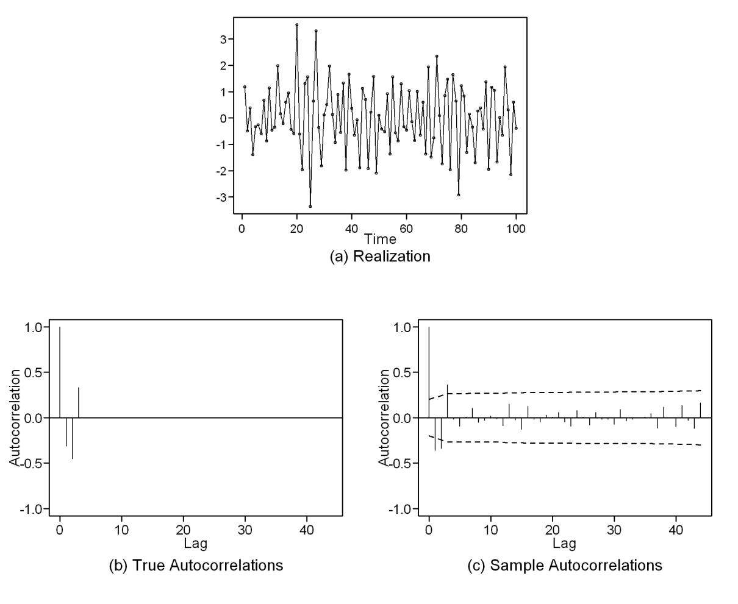
Model Identification for MA(q) Models

Slide 103
Model Identification for MA(q) Models
A rough guide for testing for an MA(q)

Slide 104
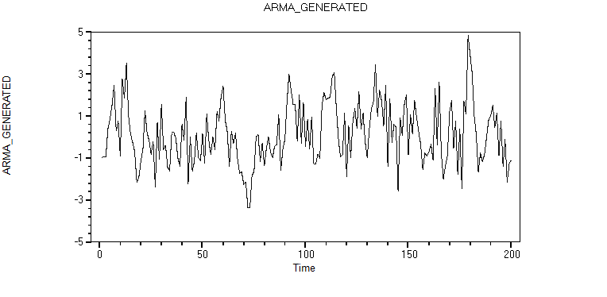
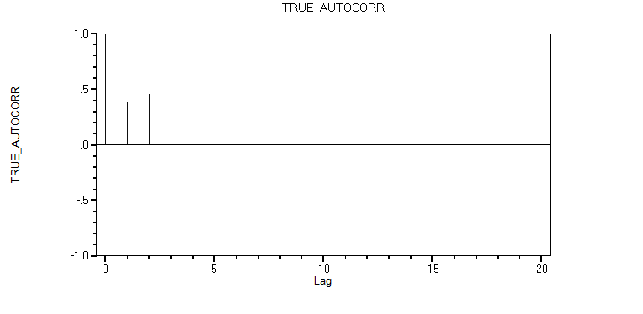
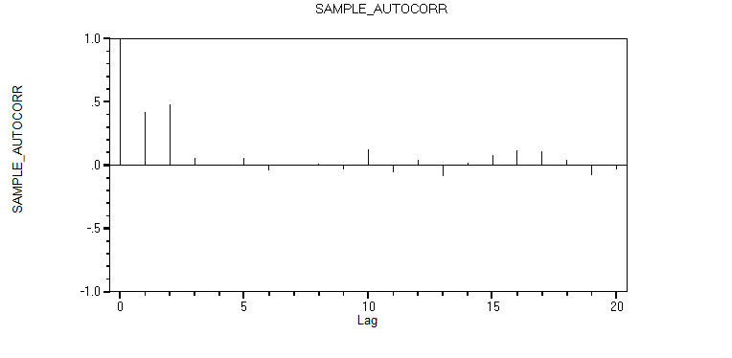
True Autocorrelations
Sample Autocorrelations

Slide 105
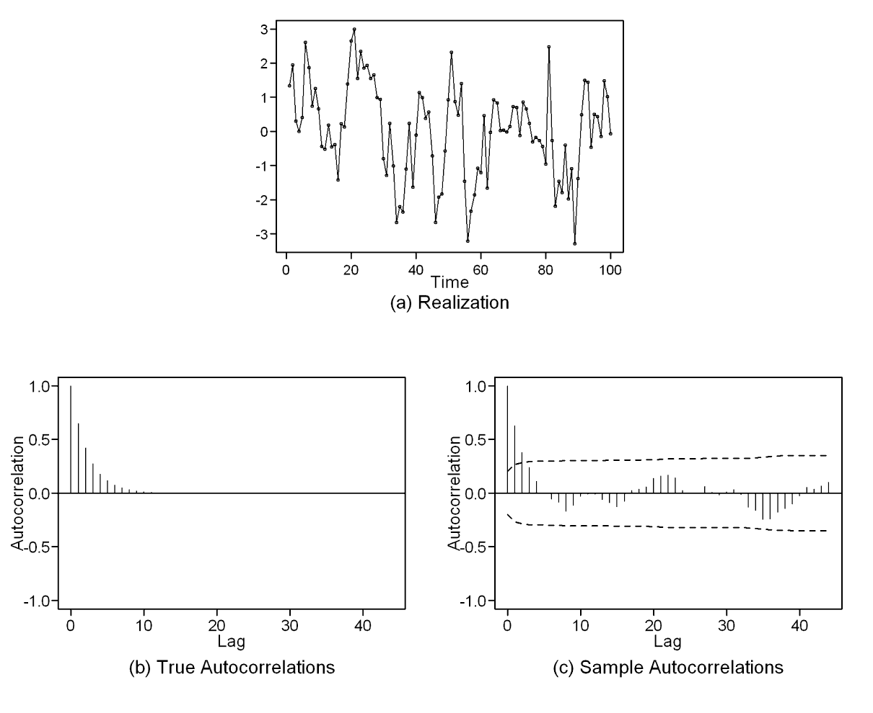
Realization
Sample autocorrelations
Only the first 2 sample autocorrelations are outside the limit lines.
But there is not a distinct drop to “nearly zero” after lag 2
Looks sort of AR-like but not sure
MA(2)?
AR(2)?

Slide 106
What Model?
True autocorrelations
Sample autocorrelations
Autocorrelation alone (even true autocorrelation) alone does not tell us.
MA?
AR?
ARMA?

Slide 108
Box-Jenkins and AR(p)
Partial Autocorrelation Function

Slide 109
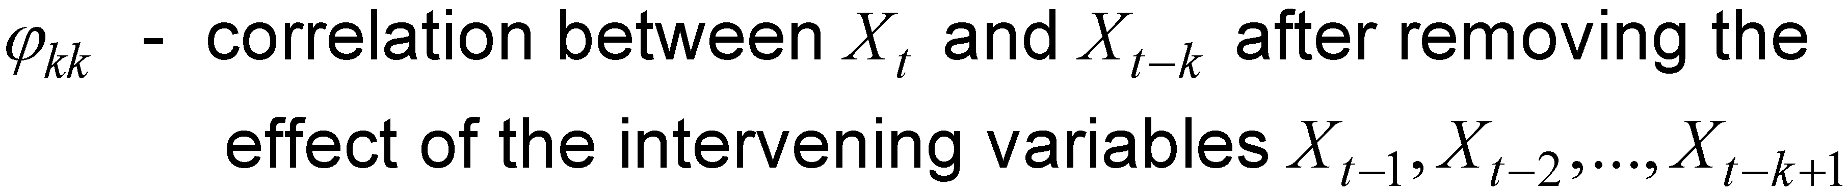
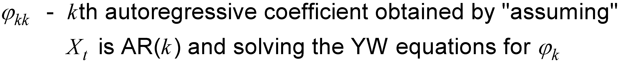
Partial Autocorrelation Function: ϕ _{kk}
Two definitions

Slide 110
Note: If X_{t} is an AR(2)
We know ϕ₂ ≠ 0
(or it wouldn’t be an AR(2))
ϕ₁ could be either zero or non-zero
then ϕ₃= 0
If we write this as an AR(p) for p > 2, then ϕ₃= ϕ₄= ··· = ϕ_{p}= 0
So:
If X_{t} ~ AR(2)
ϕ₂₂ ≠ 0
(or it wouldn’t be an AR(2))
ϕ_{kk} = 0, k > 2
t = gen.arma.wge(1000,phi = c(.3,.5), sn = 1) pacf(t)

Slide 111
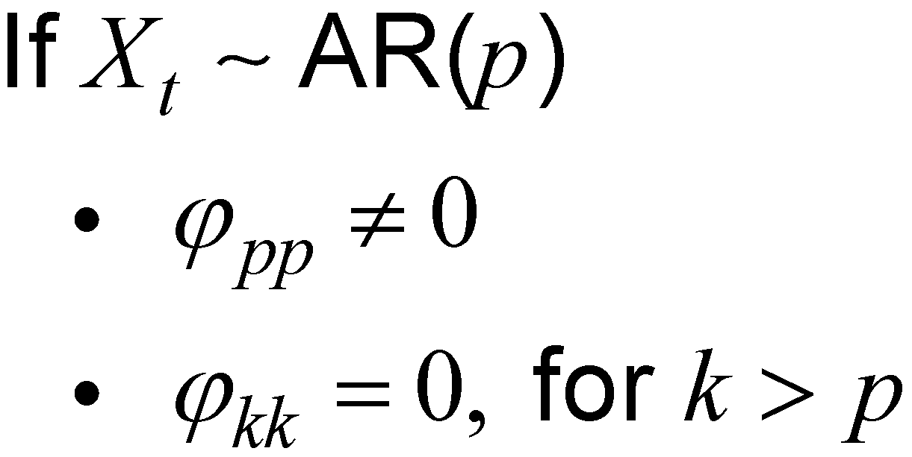
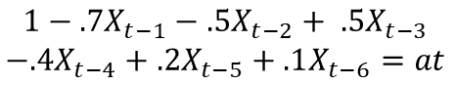
In general:
(or it wouldn’t be an AR(p))
$$1−.7X_{t−1}−.5X_{t−2}+ .5X_{t−3}$$
$$−.4X_{t−4}+.2X_{t−5}+.1X_{t−6}=at$$
$$1−.3X_{t−1} − .5X_{t−2}− .15X_{t−3}=at$$
Sample partial autocorrelations
Sample partial autocorrelations
t = gen.arma.wge(1000,phi = c(.3,.5,.15), sn = 1) pacf(t)
t = gen.arma.wge(1000,phi = c(.7,.5,-.5,.4,-.2,-.1), sn = 1) pacf(t)

Slide 113
Estimating Partial Autocorrelation from Data

Slide 114
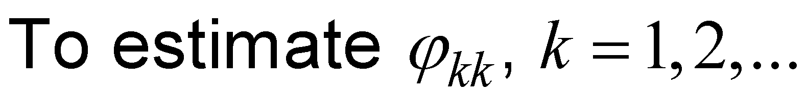
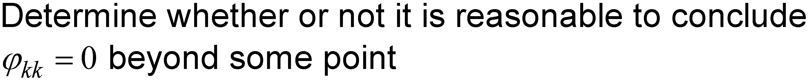
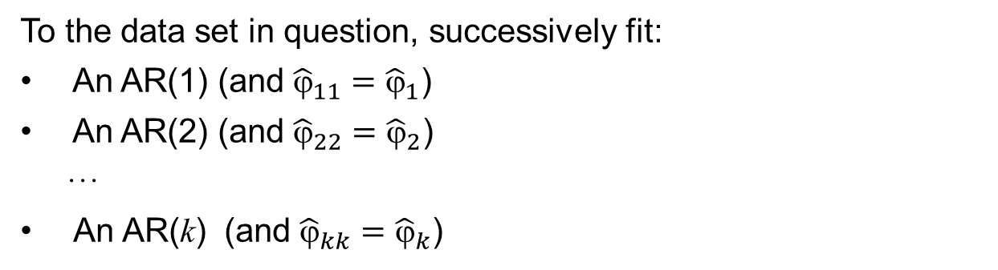
Estimating Partial Autocorrelations from Data
Use any estimation procedure (Burg, YW, MLE, etc.)
Procedure
To the data set in question, successively fit:
An AR(1) (and ${\hat{ϕ}}_{11}={\hat{ϕ}}_{1}$)
An AR(2) (and ${\hat{ϕ}}_{22}={\hat{ϕ}}_{2}$)
···
An AR(k) (and ${\hat{ϕ}}_{kk}={\hat{ϕ}}_{k}$)
(These are called sample partial autocorrelations.)
Decision rule

Slide 116
Box-Jenkins
Summary for MA(q) and AR(p)

Slide 117
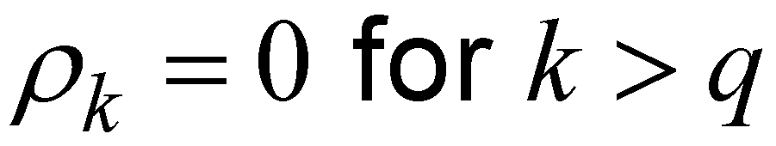
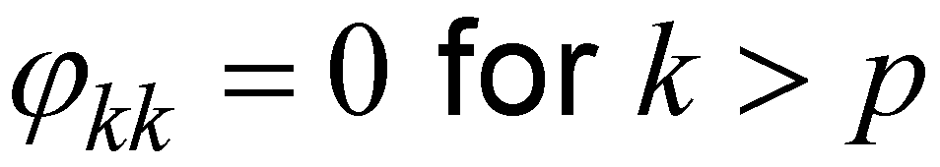
Summarizing
Box-Jenkins model identification procedure for AR(p) and MA(q) models
Sample autocorrelations
Sample partial autocorrelations
MA(q)
AR(p)
m = gen.arma.wge(2000, phi = 0, theta = c(-.5,-.7))
acf(m)
pacf(m)
t = gen.arma.wge(1000,phi = c(.7,.5,-.5,.4,-.2,-.1), sn = 1)
pacf(t)
acf(t)

Slide 119
Box-Jenkins: The Problem
ARMA(p,q)

Slide 120
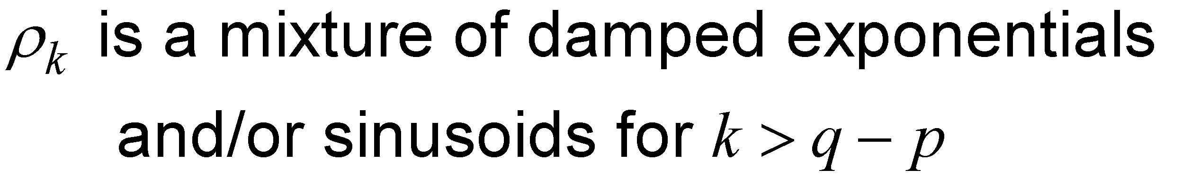
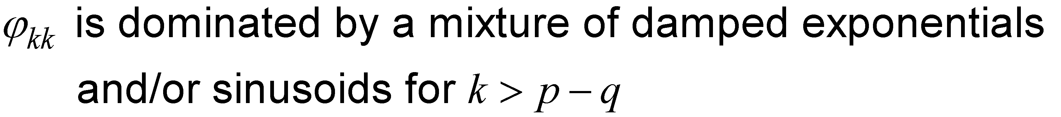
The Problem Comes When Identifying ARMA(p,q) Models with p > 0 and q > 0
Box-Jenkins procedure is based on the fact that, for an ARMA(p,q):
These patterns can be difficult to identify, even with true autocorrelations and partial autocorrelations.
Woodward and Gray (1981) developed the idea of generalized partial autocorrelations to address this issue.
However, modern model ID techniques involve AIC-type procedures.
See Woodward et al. (2017).

Slide 121
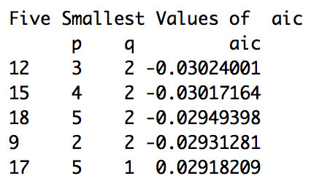
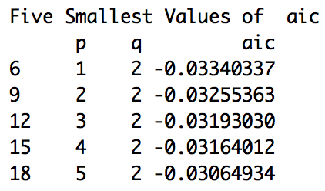
Summarizing
Box-Jenkins model identification procedure for AR(p) and MA(q) models
Sample autocorrelations
Sample partial autocorrelations
ARMA (3,2)
ARMA(1,2)
arma32 = gen.arma.wge(2000, phi = c(.7,-.5,.1), theta = c(-.5,-.7), sn = 4)
acf(arma32)
pacf(arma32)
aic5.wge(arma32)
arma12 = gen.arma.wge(2000, phi = c(.7), theta = c(-.5,-.7), sn = 4)
acf(arma12)
pacf(arma12)
aic5.wge(arma12)

Slide 123
Putting It All Together

Slide 124
Let’s Put It All Together!
In practice, we will (assuming we believe the data are from a stationary process):
Visualize/plot the data/check for white noise
Use aic.wge() or aic5.wge() to identify estimates of p and q
Use the estimate of p and q to get estimates of the phis and thetas using est.ar.wge() or est.arma.wge()
Use the estimated model to forecast and so on
Consider the data in the file PutItAllTogether.csv. Use these data to fit a the model that the AIC favors the most, and use this model to forecast the next 20 values. We will review the answers in the next element!
Notes:
ICC

Slide 125
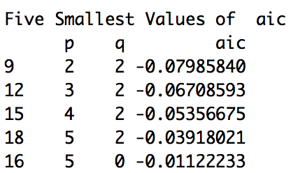
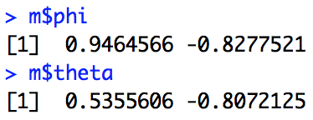
Let’s Put It All Together!
Consider the data in PutItTogether1.csv.
Visualize/plot the data.
plotts.wge(PutItTogether) #data read into array PutItTogether
Use aic.wge() or aic5.wge() to identify estimates of p and q.
aic5.wge(PutItTogether)
Use the estimate of p and q to get estimates of the phis and thetas.
m = est.arma.wge(PutItTogether, p = 2, q = 2)
Use the estimated model to forecast and so on.
fore.arma.wge(PutItTogether, phi = m$phi, theta = m$theta, n.ahead = 20)
Note: We are assuming a stationary process and have not investigated the spectral density, acfs, and so on to make sure that key properties of the data are preserved. We will address all of these topics together in the model-building unit to come!

Slide 127
Example
Jet Fuel A

Slide 128
Examples: Jet Fuel
In a previous units, we looked at jet fuel prices and found that the aic identified a model with p = 1 and q = 1 and estimated the model to be
(1 – .967B)(X_{t} – 2.20) = (1+.477B)a_{t}
We will verify the estimates of p, q, and the model parameters and use that model to forecast the next 8 months of fuel prices. Note: This assumes that we have already made the assumption that the data are stationary. We know that this assumption may be wrong and will definitely affect the forecasts.

Slide 129
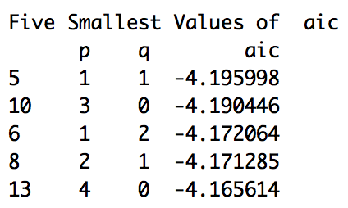
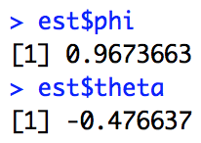
Examples: Jet Fuel
Visualize/plot the data.
plotts.wge(jet) #data read into array jet
Use aic.wge() or aic5.wge() to identify estimates of p and q.
aic5.wge(jet)
Use the estimate of p and q to get estimates of the phis and thetas.
est = est.arma.wge(jet, p = 1, q = 1)
Use the estimated model to forecast and so on.
fore.arma.wge(jet, phi = est$phi, theta = est$theta, n.ahead = 8)

Slide 131
Example
Canadian Lynx

Slide 132
Examples: Canadian Lynx Data
In a previous units, we looked at the log Canadian Lynx and found that the aic identified a model with p = 4 and q = 1 and estimated the model to be:
(1 – 0.7B – 0.1B² + 0.2B³ + 0.3B⁴)(X_{t} – 2.9) = (1 + .6B)a_{t}
We will verify the estimates of p, q, and the model parameters and use that model to forecast the next 24 months of fuel prices. Note: This assumes that we have already made the assumption that the data are stationary. We know that this assumption may be wrong and will definitely affect the forecasts.
https://figshare.com/articles/Wikipedia_Clickstream/1305770

Slide 133
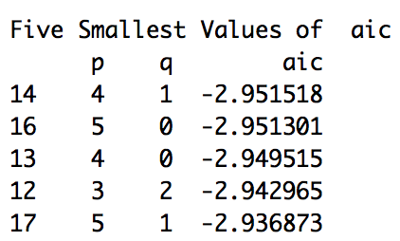
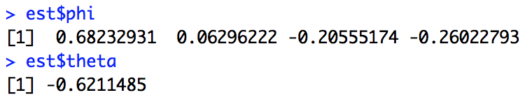
Examples: Canadian Lynx Data
Visualize/plot the data.
data(llynx) plotts.wge(llynx)
Use aic.wge() or aic5.wge() to identify estimates of p and q.
aic5.wge(llynx)
Use the estimate of p and q to get estimates of the phis and thetas.
est = est.arma.wge(llynx, p = 4, q = 1)
Use the estimated model to forecast and so on.
fore.arma.wge(llynx, phi = est$phi, theta = est$theta, n.ahead = 24)
https://figshare.com/articles/Wikipedia_Clickstream/1305770

Slide 134

Examples: Canadian Lynx Data
Visualize/plot the data.
data(llynx) plotts.wge(llynx)
Use aic.wge() or aic5.wge() to identify estimates of p and q.
aic5.wge(llynx, p = 0:15, q = 0:2)
Use the estimate of p and q to get estimates of the phis and thetas.
est = est.arma.wge(llynx, p = 11, q = 0)
Use the estimated model to forecast and so on.
fore.arma.wge(llynx, phi = est$phi, theta = est$theta, n.ahead = 24)
https://figshare.com/articles/Wikipedia_Clickstream/1305770

Slide 136
Closing Remarks
Model Identification and Parameter Estimation

Slide 137
Closing Remarks Parameter Estimation and Model Identification Summary
The basic parameter estimation method is maximum likelihood.
Burg estimates have desirable properties for AR models.
We don’t recommend using Yule-Walker estimates.
We recommend AIC-type model identification over the Box-Jenkins pattern recognition approaches.
Notes:
In this unit, we have discussed parameter estimation and model identification based on stationary models.
In the next unit, we will discuss fitting non-stationary ARIMA, seasonal, and signal-plus-noise models.

